Slide 1

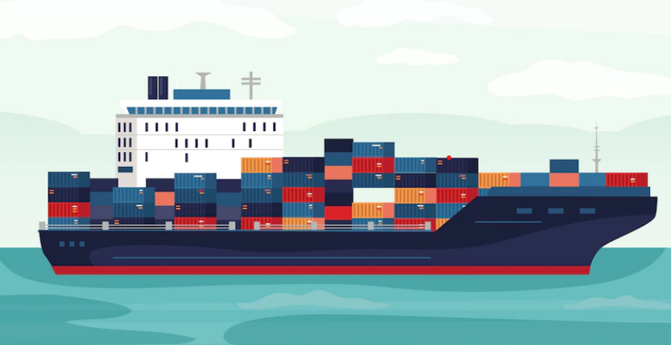

Indian cargo shipment

Slide 2
Cargo ship
A cargo ship or freighter is a merchant ship that carries cargo, goods, and materials from one port to another. Thousands of cargo carriers ply the world's seas and oceans each year, handling the bulk of international trade.
Cargo ships are usually specially designed for the task, often being equipped with cranes and other mechanisms to load and unload, and come in all sizes.
Today, they are almost always built of welded steel, and with some exceptions generally have a life expectancy of 25 to 30 years before being scrapped.
A packing list is a shipping document containing an itemized detailed list of the cargo, including weight, dimensions, safety measures, and packaging type.

Slide 3
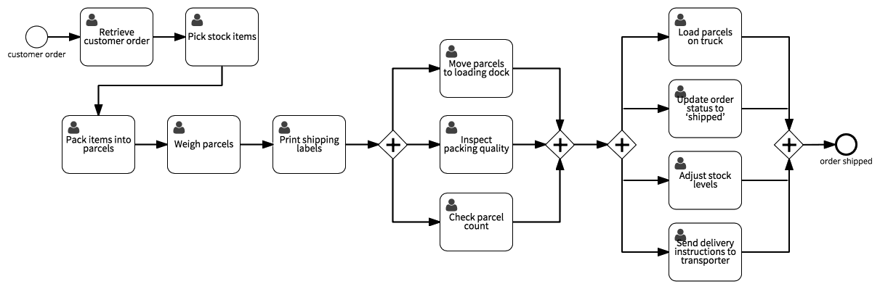
Use case Diagram

Slide 4
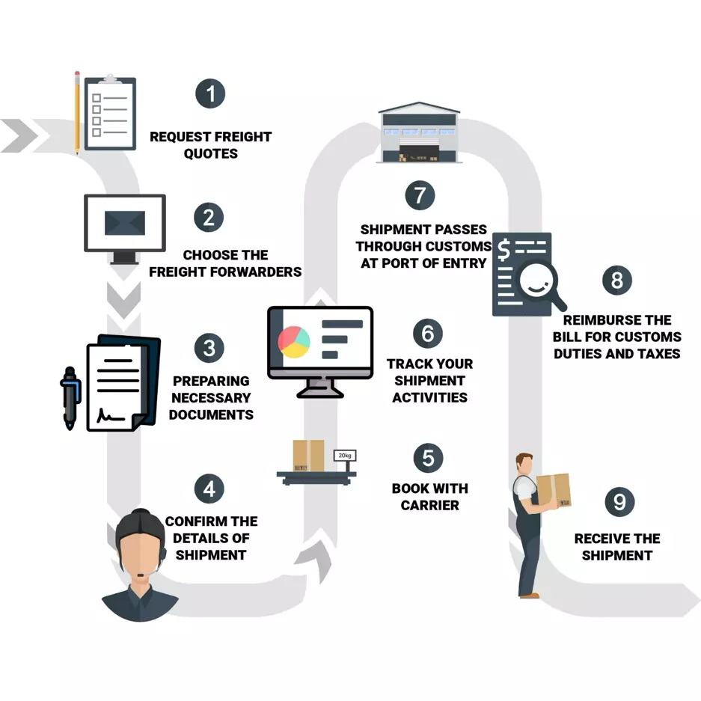
Step to step process of the total Shipping

Slide 5
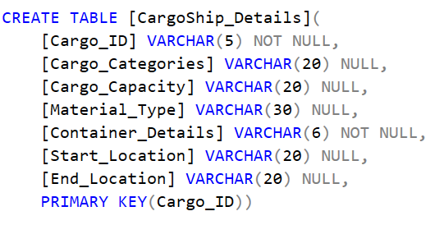
SQL table creation
Table: CargoShip_Details
CargoShip_Details table contains Ship information such as CargoID, category, cargo capacity, container details, cargo start and end location.

Slide 6
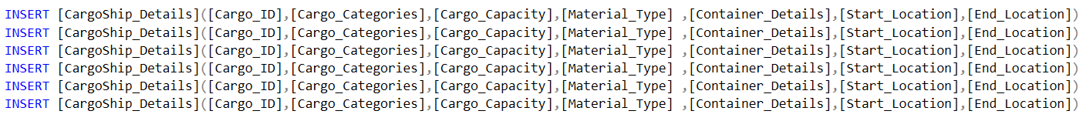
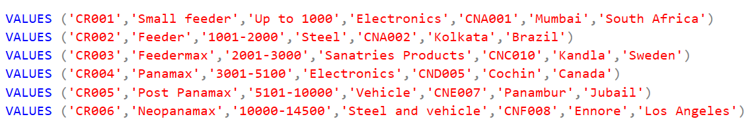
Insertion of values
The following SQL statement insert the new record in the CargoShip_Details Table.
INSERT [CargoShip_Details]([Cargo_ID],[Cargo_Categories],[Cargo_Capacity],[Material_Type] ,[Container_Details],[Start_Location],[End_Location]) VALUES ('CR001','Small feeder','Up to 1000','Electronics','CNA001','Mumbai','South Africa')

Slide 7
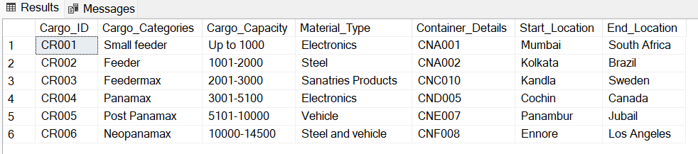
Output of the table
Output of the CargoShip_Details:

Slide 8
Thank you

